Slide 1
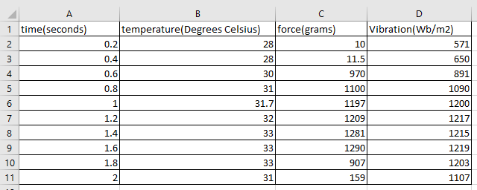
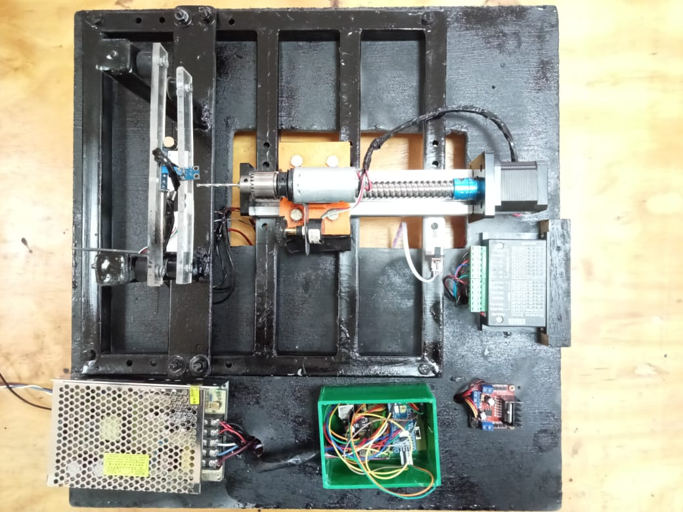
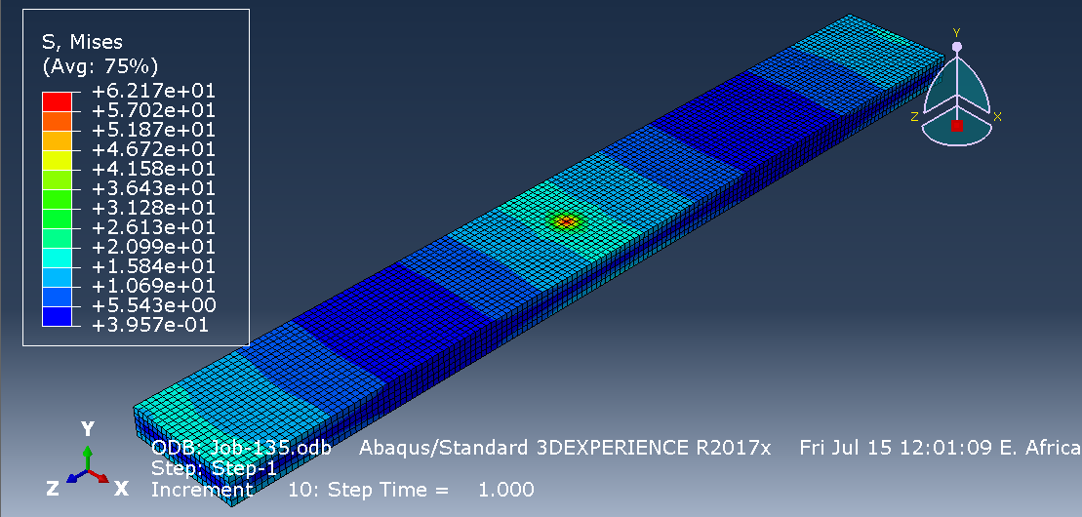
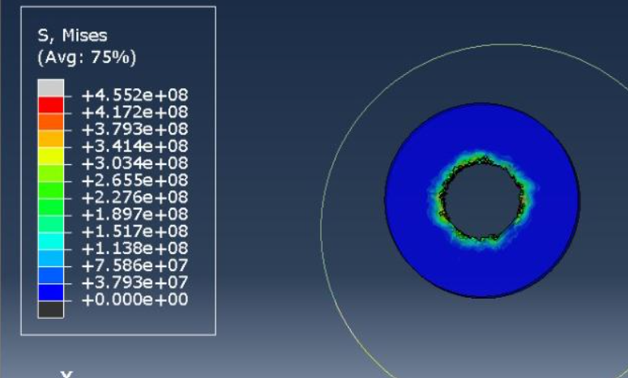
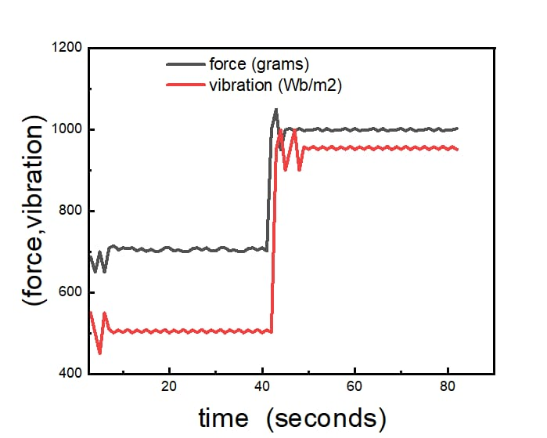
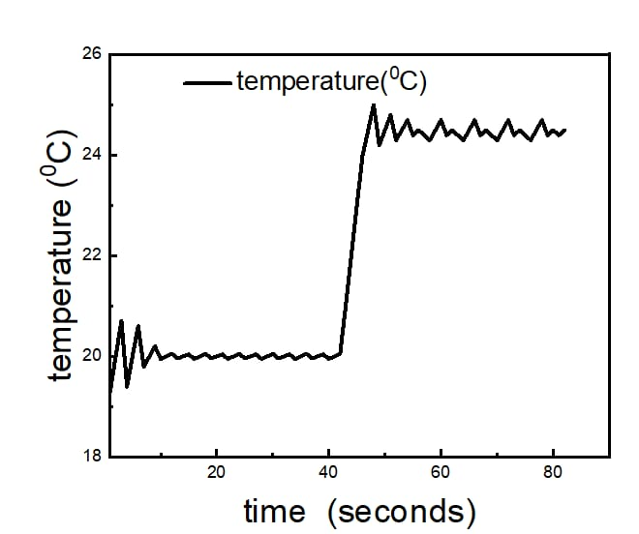
GROUP MEMBERS
Mary Mbaire Mbugua
Renox Kipkoech
Morris Lesinko
4. Philip Katiechi
5. Allan Kyalo
6. Stephen Gitau
STUDY AND DEVELOPMENT OF
AN AUTOMATED
1-AXIS DRILL
29TH June, 2023
Supervisor: Dr. Titus Mulembo
OVERVIEW
MAIN OBJECTIVE
Development of a precise automated one axis drill.
Specific Objectives
To design and simulate 3D model of the physical system
To develop project circuits and firmware to run sensors, actuators and peripherals.
To carry out experiments and analysis to determine parameters for vibration mitigation
ABSTRACT
High quality drilled holes are required in a lot of industrial and medical applications. It is imperative to design a low cost and precise drilling machine that can be used and which monitors vibrations resulting and forces applied to the workpiece during the drilling operation. This project focuses on the development of a one-axis drill system utilizing a polymer workpiece for improving bone drilling operations in medical applications. System monitoring is essential to determine the best parameters that can be used in system control for vibration mitigation while using analytical and computational resources to analyze behavior of PMMA under drilling operation while ensuring reduced chatter or risk if drill bit breakage and ensuring efficient material removal.
EXPECTED OUTCOMES
To come up with a firmware program to simulate the working of sensors, actuators and peripherals for efficient drilling operation
To carry out e
To analyze forces and vibration on the PMMA with respect to drill and feed speeds
EXPERIMENTAL WORK
Sample Sensor Data
Fabricated Drill Set Up
VARIABLES
Feed rate
Spindle speed
Drill bit diameter
Hole Depth
RESULTS
Analysis of PMMA when subjected to a load
Temperature evolution upon drilling
Graph of vibration (Wb/m²) against time (seconds)
Graph of Temperature (Degrees Celsius) against Time (seconds)
CONCLUSION
The condition of the drilling action was monitored using the three sensors; temperature, force, and vibration sensors.
Data was collected and transmitted to an external computer module via Bluetooth.
The data was simulated and analyzed using Matlab.

